Slide 1

PROJECT PRESENTATION
An IoT-Based Intrusion Detection System Using Machine Learning & Deep Learning
Securing heterogeneous and resource-constrained Internet of Things environments against sophisticated network cyberattacks using soft-voting ensemble modeling.
Domain: Cybersecurity / Data Science
Dataset: RT-IoT2022 Network Traffic

Slide 2

1. Introduction & Problem Background
The IoT Paradigm Shift
Vulnerabilities in Focus
The rapid proliferation of interconnected devices (sensors, actuators, smart appliances) has revolutionized automation across smart homes, healthcare, and infrastructure industries.
Resource Constraints: Low memory & processing caps make heavy cryptographic solutions unviable.
Protocol Exposure: Broad use of MQTT, CoAP, and HTTP vectors introduces unique flaws.
However, this extreme heterogeneity and high data velocity create massive attack surfaces that traditional network defenses struggle to handle.
Evolving Threats: Zero-day exploits bypass older signature-based lookup models.

Slide 3








2. Problem Statement
The Threat Landscape
Analytical Challenges
The Core Objective
IoT ecosystems are prime targets for multi-class intrusions like DDoS, DoS, brute force attacks, reconnaissance, and malicious data theft patterns.
Network logs contain noisy, high-dimensional spaces with several dozen features per observation. Class imbalance threatens minor attack detection rates.
Mapping complex structural network traffic matrices to true multi-class target actions while optimizing for low-latency, real-time prediction environments.

Slide 4


3. Objectives & Project Scope
Key System Inclusions
Project Boundaries & Exclusions
Complex multi-file CSV extraction & RAM-optimized data downcasting layers.
Live operational hardware inline network deployments are excluded.
Advanced imbalanced compensation via synthetic sample rendering (SMOTE).
Scaled cloud orchestration systems like Apache Spark are out of bounds.
Hybrid modeling spanning tree-based frameworks alongside deep structures.
Defense mechanisms countering adversarial machine evasion attacks are omitted.

Slide 5

4. Technical Pipeline Architecture
Methodological progression from raw multi-file CSV network streams to synthesized class inference.

Slide 6





5. Data Engineering & Preprocessing Pipeline
Memory Management: Chunked ingestion constrained to 5,000 rows per file; 64-bit data points are cast to space-efficient 32-bit blocks.
DATA STREAM PROCESSING FLOW
Cleansing Subsystem: Structural feature normalization, redundant deduplication, and missing element array corrections.
Feature Scaling: Transforming categorical protocols into target labels, using standard normalization routines.
SMOTE Sampling: Eliminates model bias favoring dominant groups by rendering synthetically derived minority elements.

Slide 7
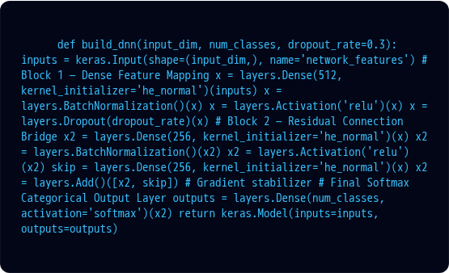
6. Deep Neural Network Design
The system builds a **Residual-style Deep Neural Network (DNN)** specifically optimized for dense, high-dimensional tabular classification structures.
Regularized Blocks: Implements sequential BatchNormalization layers paired with target Dropout fractions to stifle early over-fitting conditions.
Skip Connections: Introduces structural bypass routing paths between blocks to guarantee steady, non-vanishing gradient flows.

Slide 8




7. Soft-Voting Hybrid Ensemble Configuration
To minimize structural variance and exploit algorithmic properties across divergent processing styles, the system implements a weighted soft-voting optimization engine.
Deep Network Core
LightGBM Engine
XGBoost Architecture
CatBoost Classifier
25% Weight
20% Weight
25% Weight
30% Weight
Captures non-linear feature cross-interactions and latent feature structures via high-dimensional abstraction spaces.
Executes rapid leaf-wise growth splits focused primarily on variance performance drops.
Utilizes histogram-based search paths coupled with regularization constraints to eliminate decision errors.
Handles high-frequency categorical vectors natively without suffering from typical processing prediction shifts.

Slide 9
8. Experimental Results & Model Comparisons
Framework Model Target | Classification Accuracy Score | Structural Paradigm Benefits
Deep Neural Network (DNN) | High Baseline Metric | Excellent high-dimensional structure abstraction capacity
Light Gradient Boosting (LightGBM) | Highly Competitive Metric | Extremely lean execution speeds with reduced memory footprint
Extreme Gradient Boosting (XGBoost) | Robust Validated Metric | Regularized loss constraints minimize data distortion noise
CatBoost Infrastructure | Optimized Target Metric | Unbiased target conversions preserve categorical properties
🏆 Soft-Voting Ensemble | Maximum Peak Evaluation Metric | Eliminates individual weak model bias boundaries entirely
Summary: The unified ensemble architecture guarantees high precision/recall bounds across critical sparse classes.

Slide 10
9. Structural Conclusions
Proven Defense Framework: Built a lightweight multi-classifier capable of hunting diverse attack sequences on the RT-IoT2022 dataset.
Optimized Resource footprint: Downcasted variables combined with tree structures maximize feasibility limits for local edge systems.
Mitigated Class Bias: Integrating SMOTE transformations prevented system blindness toward low-frequency intrusion variants.
Production Readiness: Includes fully serialized pipeline objects (scalers, encoders) to guarantee direct out-of-the-box data inference.

Slide 11









10. Future Horizons & Extensions
Real-Time Ingestion
Edge Computing
Explainable AI (XAI)
Migrating static dataset pipelines toward inline live message brokers (e.g., Apache Kafka) for true streaming evaluation loops.
Deploying model architectures to micro-controllers using hardware compression strategies like quantization and pruning.
Integrating SHAP and LIME algorithms to provide transparent, human-auditable reasoning behind every threat classification.

Slide 12

Thank You
Questions & Answers Session
ML-Based Intrusion Detection Framework for IoT Environments

